Slide 1
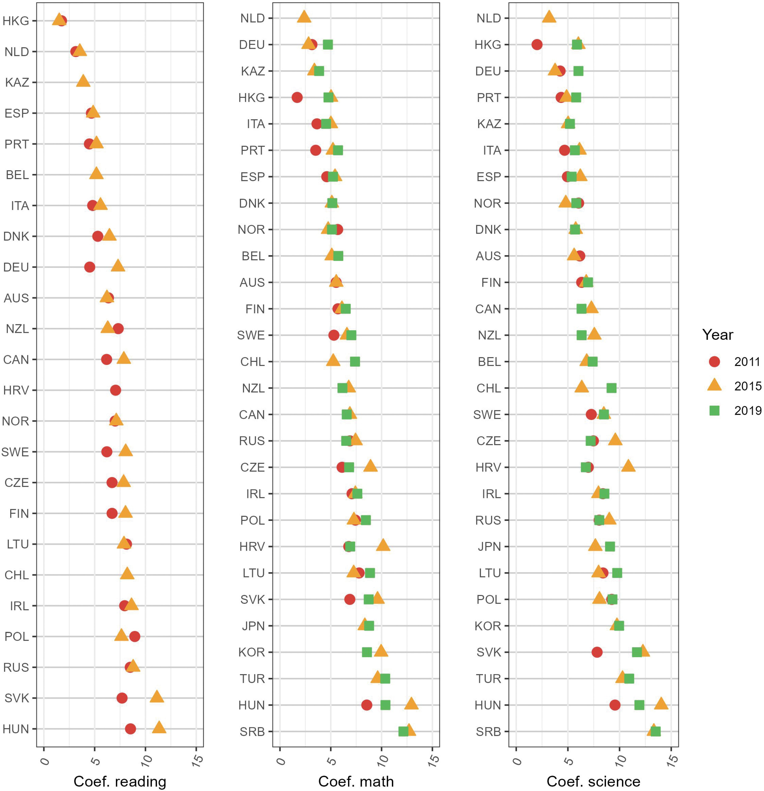

Figure 3 Unstandardized coefficients from OLS regressions predicting student reading, math, and science scores from ...
Notes:
Figure 3 Unstandardized coefficients from OLS regressions predicting student reading, math, and science scores from parental education across each country and year. Note: OLS regression includes controls for sex, migration, age, GDP per capita, and public education spending. See full data table in online Supplementary Section D. Image of unstandardized coefficients from OLS regressions predicting student reading, math and science scores from parental education across each country and year including controls.
Unless provided in the caption above, the following copyright applies to the content of this slide: © The Author(s) 2024. Published by Oxford University Press.This is an Open Access article distributed under the terms of the Creative Commons Attribution License (https://creativecommons.org/licenses/by/4.0/), which permits unrestricted reuse, distribution, and reproduction in any medium, provided the original work is properly cited.

